Slide 1
2+1
The Good, The Bad and The Ugly
Karl Sawyer, PE KYTC
Jeff Jasper, PE KTC
Kyle Chism, PE Parsons
Notes:
Welcome to “2+1 The GOOD, The BAD, and The UGLY” - 2+1 Design of 5-8954.
First off, Keith Downs, KYTC Project Manager for 5-8954 was supposed to present today, but he had to be out of town. When Kyle and Jeff found out, they reached out to find someone to fill in.

Slide 2
Notes:
But, NONE of these guys were available, So….
When they couldn’t get their 1st choice of Clint Eastwood,
they had to turn to their second choice…

Slide 3
Notes:
But Clyde declined too!! Some of you younger folks may need to google those references.

Slide 4
COMPANY OVERVIEW
Item No. 5-8954.00 KY 55/KY 155 Spencer and Jefferson Counties
Project Phase | Funding Year | Amount
Design | 2022 | $470,000
Right-of-Way | 2023 | $40,000
Utilities | 2023 | $820,000
Construction | 2024-2025 | $16,000,000
Project Total |  | $17,330,000
Notes:
So, they had to settle for me. I’m Karl Sawyer, Location Engineer for District 5.
This is the 6YP Information for 5-8954.00

Slide 5
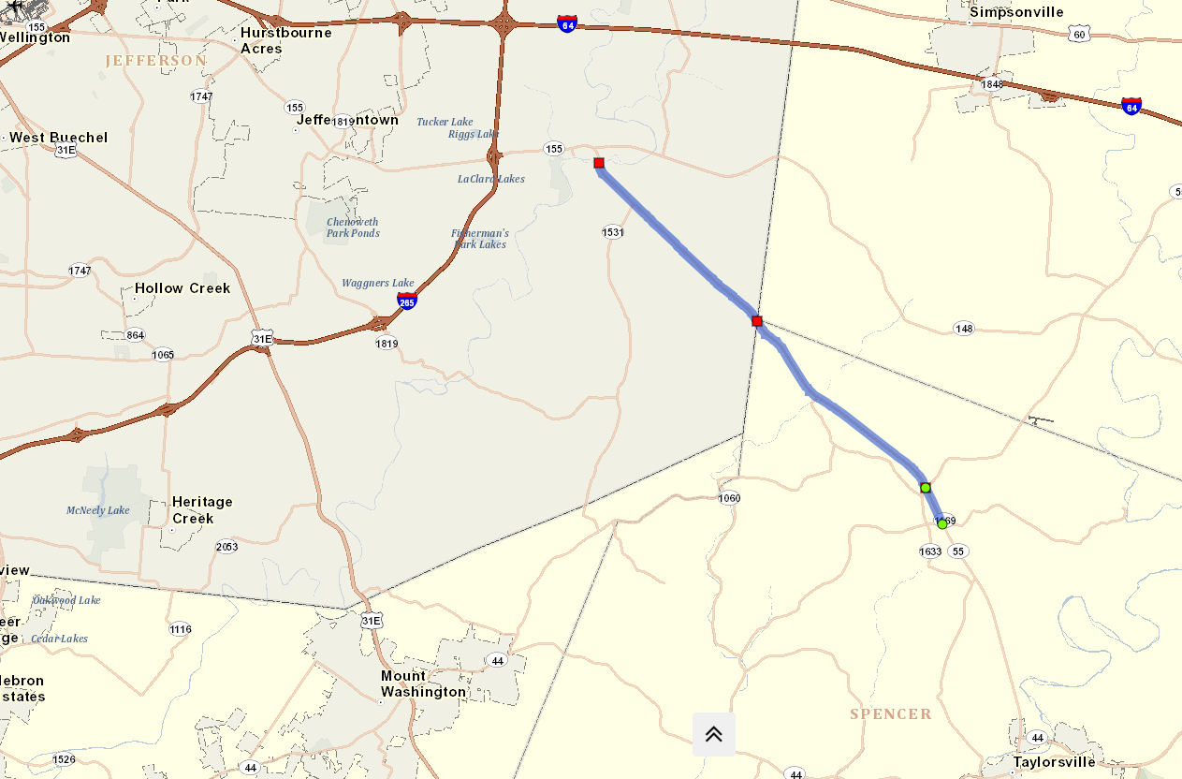
LOUISVILLE
END 5-8954.00
COUNTY LINE
KY 55
KY 155
BEGIN 5-8954.00
KY 55
TAYLORSVILLE
Notes:
Here are the project limits of 5-8954:
Beginning on KY 55 (Taylorsville Road) in the Wild West section of Spencer County, and ending on KY 155 (Taylorsville Lake Road) in Jefferson County.
This section of roadway is an existing 2 lane section with a lot of commuter traffic heading to/from Louisville on weekdays, and weekend recreational traffic heading to/from Taylorsville Lake.
So Why 2+1?

Slide 6
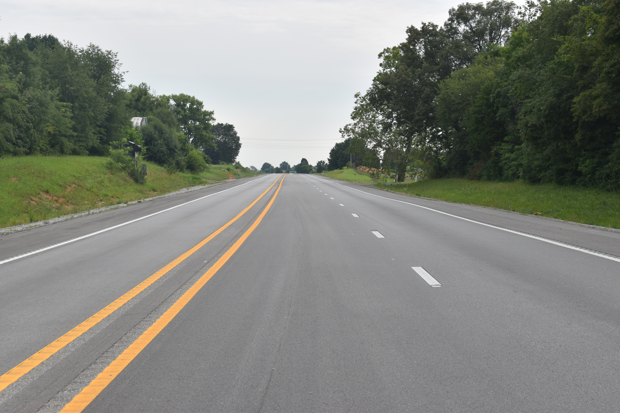
Notes:
Here is an existing 2 +1 Roadway Here in Kentucky
2+1 roadways are still somewhat new in the US, but the design is gaining some popularity in Kentucky.
In fact, Kentucky is kind of in the fore front of 2+1 Designs in the US.

Slide 7
Known 2+1 Roadways in the united states
Facility Type | Project Number | Location | Route | Length | Existing AADT
2+1 | 8-8851.00 | Adair County, KY | KY 55 | 6.23 miles | 7,242 (2018)
2+1 | 4-8920.00 | Taylor County, KY | KY 55 | 8 miles | 8,404 (2018)
2+1 | BUILD Grant | Taylor County, KY | US 68 | 4.68 miles | 9,575 (2019)
2+1 | 4-8917.00 | Marion County, KY | US 68 | 9.36 miles | 8,750 (2020)
2+1 | 4-8916.00 | Marion County, KY | KY 55 | 4.67 miles | 10,015 (2019)
2+1 | 4-8916.01 | Washington County, KY | KY 55 | 2.8 miles | 8,650 (2017)
2+1 | 4-396.10 | Nelson/Washington County, KY | US 150 | 11.4 miles | 13,854 (2019)
 |  | OTHER STATES
2+1 |  | Missouri | SR 5 | 16.5 miles | 10,000 (2021)
2+1 |  | California | SR 1 | 8.3 miles | 9,900 (2019)
2+1 |  | Arizona | SR 77 | 8 miles | 4,700 (2019)
Notes:
This Chart shows some known locations for existing 2+1 roadways.
The top section are Kentucky Projects.
The bottom section are other states.

Slide 8
Known 2+1 Roadways in the united states
Facility Type | Project Number | Location | Route | Length | Existing AADT
2+1 | 8-8851.00 | Adair County, KY | KY 55 | 6.23 miles | 7,242 (2018)
2+1 | 4-8920.00 | Taylor County, KY | KY 55 | 8 miles | 8,404 (2018)
2+1 | BUILD Grant | Taylor County, KY | US 68 | 4.68 miles | 9,575 (2019)
2+1 | 4-8917.00 | Marion County, KY | US 68 | 9.36 miles | 8,750 (2020)
2+1 | 4-8916.00 | Marion County, KY | KY 55 | 4.67 miles | 10,015 (2019)
2+1 | 4-8916.01 | Washington County, KY | KY 55 | 2.8 miles | 8,650 (2017)
2+1 | 4-396.10 | Nelson/Washington County, KY | US 150 | 11.4 miles | 13,854 (2019)
2+1 |  | Missouri | SR 5 | 16.5 miles | 10,000 (2021)
2+1 |  | California | SR 1 | 8.3 miles | 9,900 (2019)
2+1 |  | Arizona | SR 77 | 8 miles | 4,700 (2019)
Notes:
Note the KY 55 Pattern, in fact I think the US 68 projects share the KY 55 nameplate.

Slide 9
COMPANY OVERVIEW
Item No. 5-8954.00 KY 55/KY 155 Spencer and Jefferson Counties
Project description: Construct a 2+1 road on KY 55/155 (Taylorsville Road) in Spencer County and KY 155 (Taylorsville Lake Road) in Jefferson County by adding a continuous third lane that serves as an alternating passing lane.
Project Phase | Funding Year | Amount
Design | 2022 | $470,000
Right-of-Way | 2023 | $40,000
Utilities | 2023 | $820,000
Construction | 2024-2025 | $16,000,000
Project Total |  | $17,330,000
Notes:
Why 2+1? This is the rest of the 6YP Information for 5-8954.00
Looking at the previous Chart, One could hardly blame the legislators for adding the “2+1” designation to this KY 55 project description. But is it right for this project?
Today we are going to talk about The Good, what they do well The Bad, where they have some short comings, and The Ugly, where they could have some serious issues as discovered in the preliminary 2+1 design of 5-8954
In a few minutes, Kyle is going to discuss some of the analysis performed showing that maybe this location wasn’t such a good candidate for a 2+1 roadway,
and how we presented that information to Local Elected Officials and other key stake holders.
But first, Jeff is going to give us quick lesson in 2+1 Roadways, What they are, and some critical design elements.

Slide 10
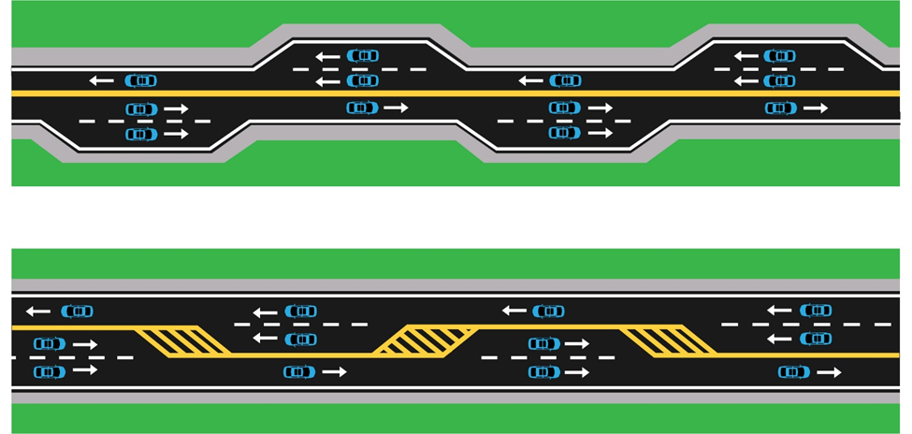
Asymmetrical & Symmetrical
2+1 Roadway Configurations
Notes:
2+1 configurations provide a viable design alternative for high-speed rural highways that have moderate traffic volumes. Passing lane segments can significantly improve traffic flow.
Passing lane segments can significantly improve traffic flow.

Slide 11
Notes:
1200 veh/hr = 20 veh/minute = one vehicle every three seconds

Slide 12
Arrow #1
Arrow #2
Notes:
60mph = 88 feet per sec; 3 sec is approximately 260 feet; Basketball court in 94 feet. This is the length of three basketball courts.
the merging behavior of vehicles at the end of the passing lane can become problematic at high traffic flow rates and high percentage of heavy vehicles. Higher flow rates reduce the average gap between vehicles, which forces drivers to merge into smaller gaps. This behavior impacts the traffic flow, as following vehicles must decelerate for the merging vehicles. At some point, a breakdown is reached, and the performance of the passing lane degrades below that of a non–passing lane segment.
Highway Capacity Manual 7th Edition: A Guide for Multimodal Mobility Analysis. Washington, D.C.: Transportation Research Board, 2022.

Slide 13
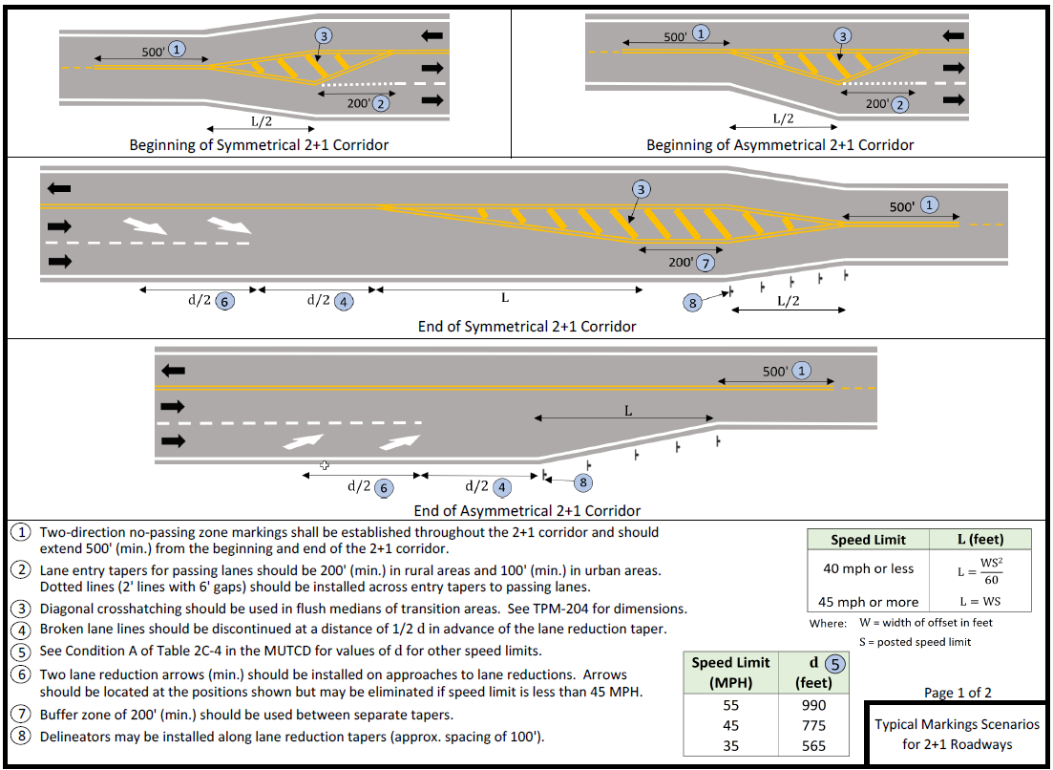
Notes:
Clear signage and pavement markings are essential to the operation of 2+1 passing lanes. Signing and marking plans should be developed for 2+1 facilities. The plans should be coordinated with the Division of Traffic Operations and be developed in compliance with the Traffic Operations Guidance Manual and the latest edition of the Manual on Uniform Traffic Control Devices.

Slide 14
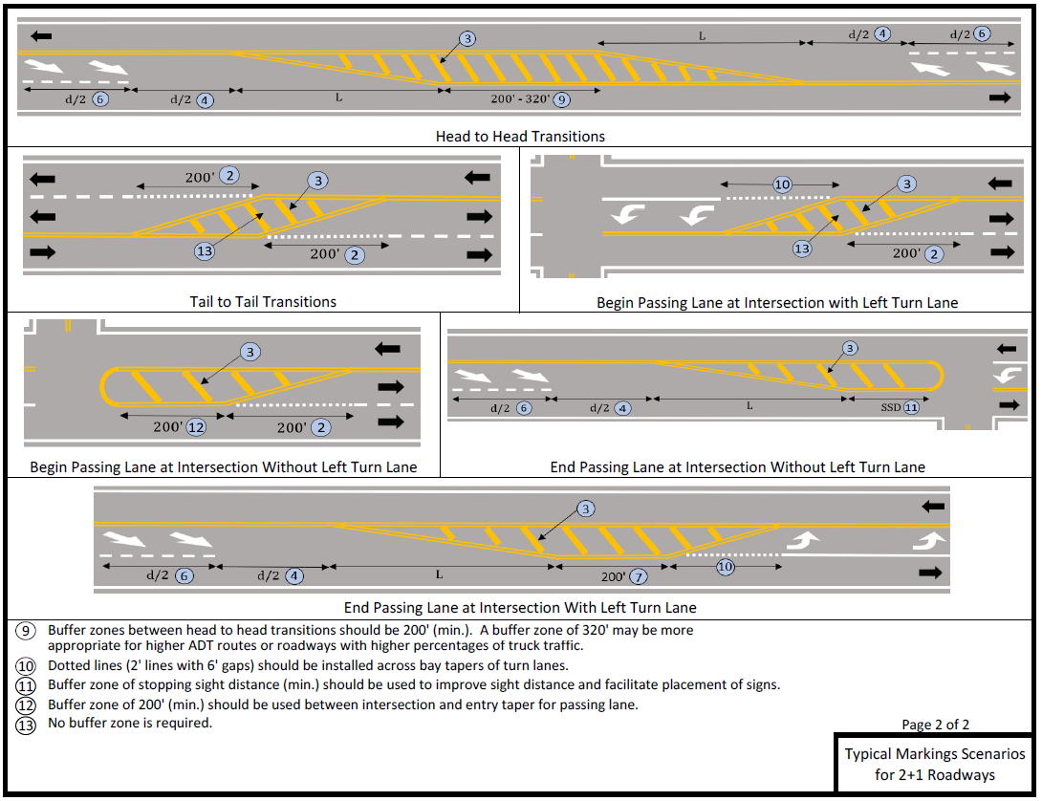
Notes:
Clear signage and pavement markings are essential to the operation of 2+1 passing lanes. Signing and marking plans should be developed for 2+1 facilities. The plans should be coordinated with the Division of Traffic Operations and be developed in compliance with the Traffic Operations Guidance Manual and the latest edition of the Manual on Uniform Traffic Control Devices.

Slide 15
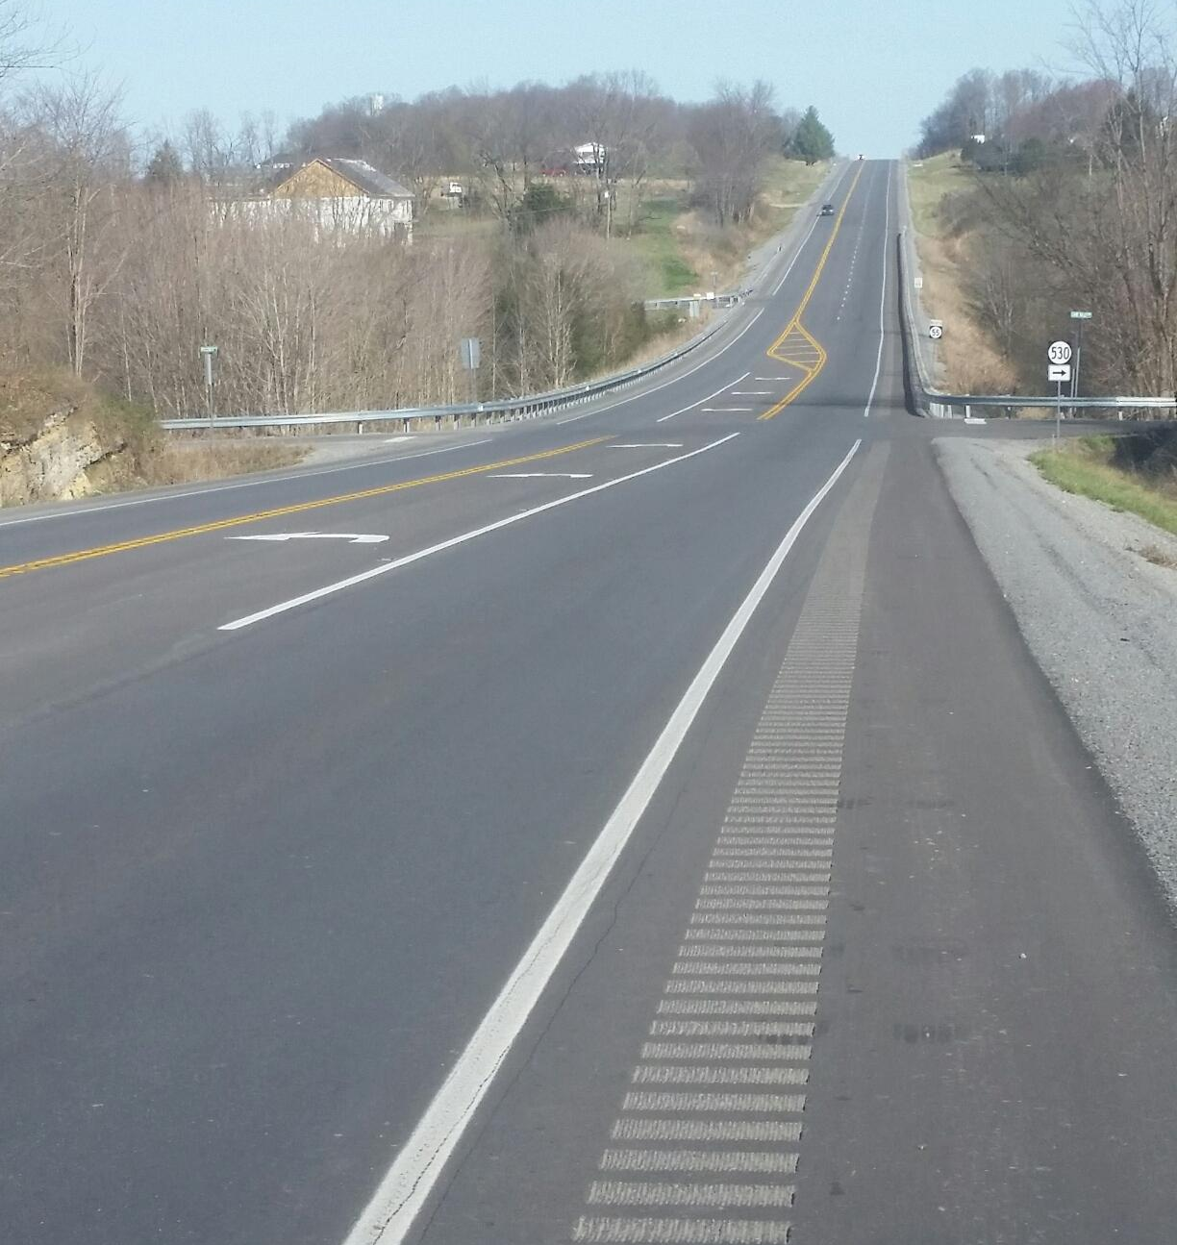
Notes:
Passing lanes should be located away from major intersections and high-volume driveways to decrease the probability of speed differentials between turning and passing traffic. Major intersections should be located in the transition area between opposing passing lanes, and conventional left-turn lanes should be provided at the intersection. Low-volume intersections and driveways may be accommodated within passing lanes sections but not within taper transition areas.

Slide 16
Notes:
Passing lanes should be located away from major intersections and high-volume driveways to decrease the probability of speed differentials between turning and passing traffic. Major intersections should be located in the transition area between opposing passing lanes, and conventional left-turn lanes should be provided at the intersection. Low-volume intersections and driveways may be accommodated within passing lanes sections but not within taper transition areas.

Slide 17
Alternatives Discussion
ENTIRE CORRIDOR ALTERNATIVES
No Build
Alternative 1 – 2+1 – Baseline configuration
2+1 Roadways
Alternative 2 - 5-Lane
Alternative 3 - Hybrid
BUILD TO BUDGET ALTERNATIVES
Alternative 4 – Northern 5-Lane
Alternative 5 – Priority Hybrid
Notes:
5 alternatives considered + no-build

Slide 18
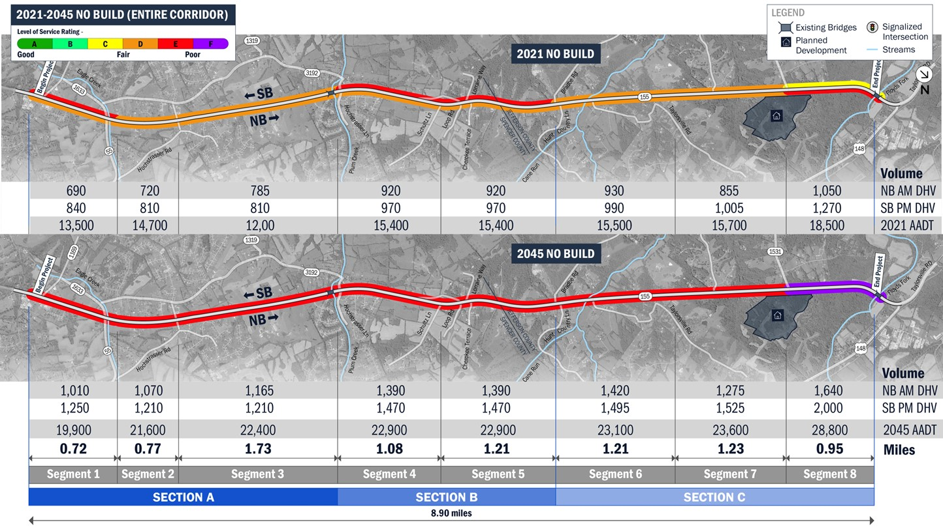
No-build Alternative
Notes:
Always have no-build for environmental document
KYTC HD Memo 01-22
5,000 < Design ADT < 15,000 consider 2+1
15,000 < Design ADT < 20,000 2+1 for initial, but purchase R/W for 5-lane section
Existing condition ADT > 15,000 for much of corridor
Design year ADT > 20,000 for much of corridor
No-build still level E for all but segment 8 (note differences from typical no-build)

Slide 19
2+1 Alternative
Notes:
Simple way to differentiate alternatives for LEOs
PM Peak period worst case
Typical sections
Cost/benefit
LOS
Segment length and how segments were determined (major crossroads/entrance density/passing lane transition locations)
Passing lanes direction based on existing access points, not grades
Similar LOS in opposite direction for AM peak
Measure of utility

Slide 20
Segment definition NB 2+1
Notes:
Entrance density key to location of passing lane – minimize turns in the passing lane

Slide 21
5-lane Alternative
Notes:
5-lane alternative not initially scoped, but were concerned about existing and design AADT
5-lane provides necessary capacity and plans for additional access points/development.
Project budget insufficient for entire corridor.
Road plan description lists project as 2+1.

Slide 22
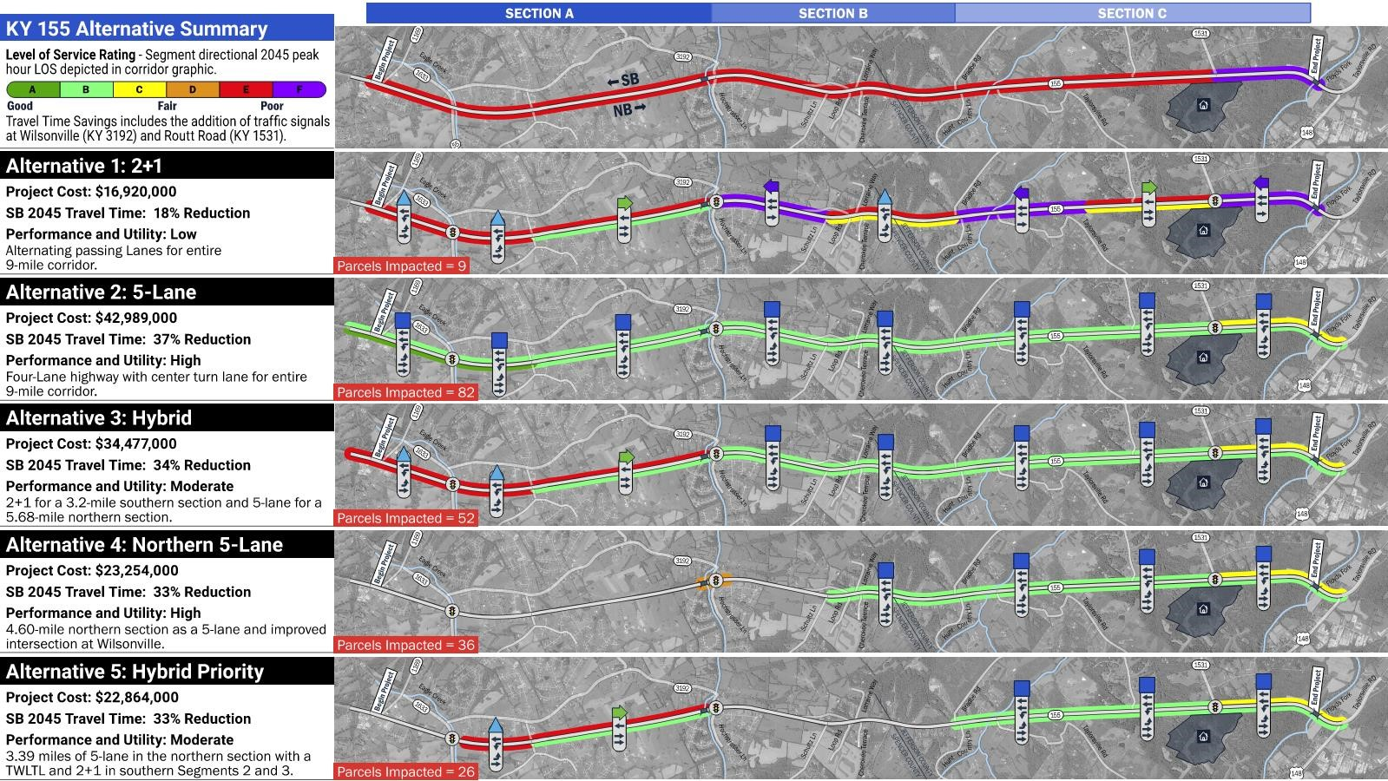
Alternatives summary
Notes:
Overview provided side by side comparison of all alternatives.
Hybrid alternative meets corridor needs at lowest cost
Build to budget alternatives (4 and 5) developed based on available construction budget. Provide greatest benefit within construction budget.

Slide 23
preferred Alternative
$21,460,000
$3,214,000
$8,475,000
$33,149,000
Remaining corridor segments addressed in future road plans
Extend 5-lane through Plum Creek Bridge
Notes:
Preferred alternative 5-lane through plum-creek bridge
LEO’s committed to revising road plan description
Additional project funding (DRUC) will be added to next road plan

Slide 24
Questions / COMMENTS

